Slide 1
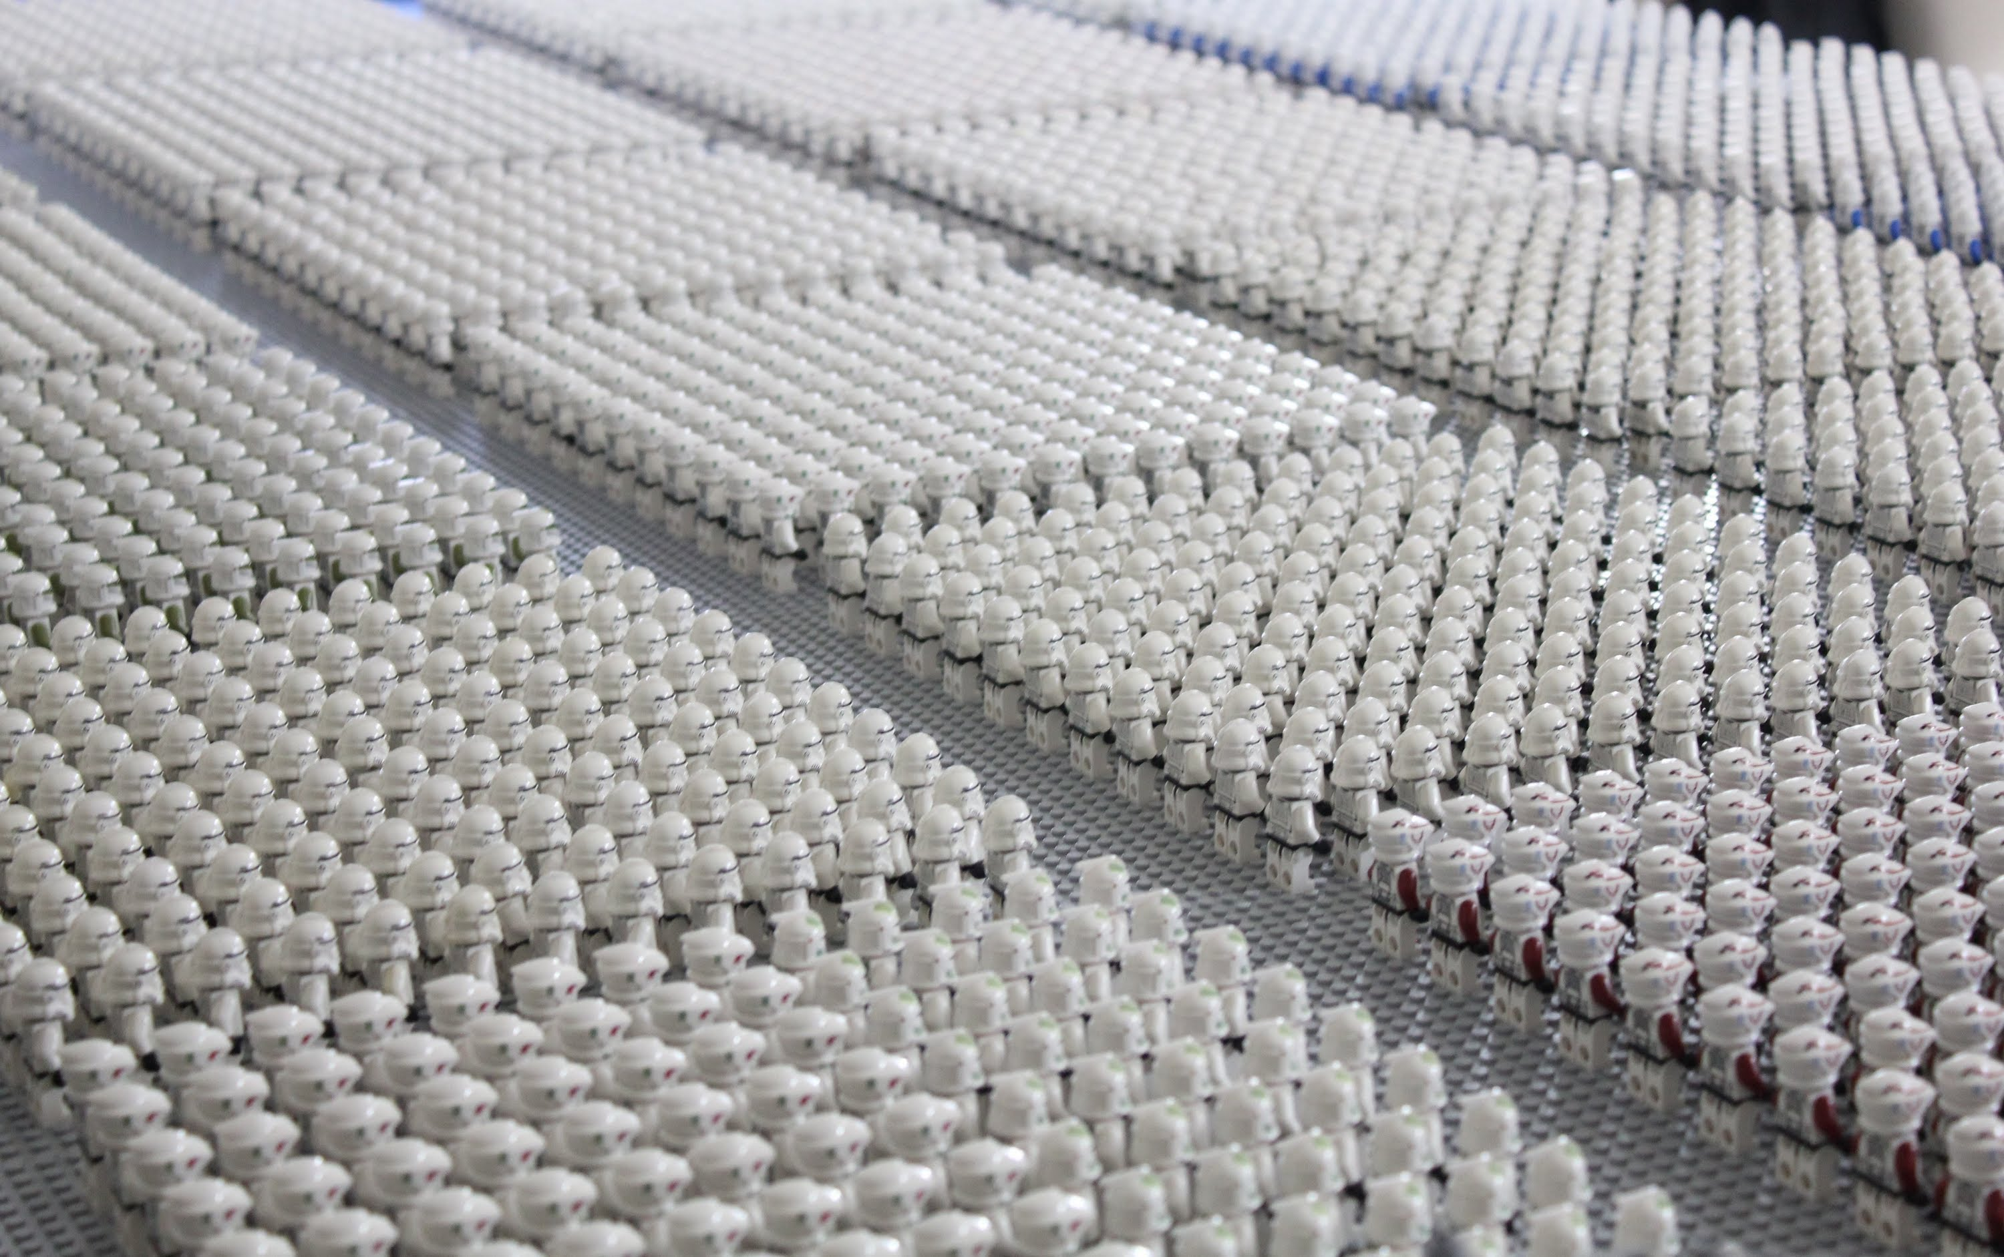
How Many Copies Is Enough?

Slide 2
How Many Copies Is Enough? A Flexible, Replicable Simulation Framework for Assessing Storage Risk
Prepared for
iPRES 2015
Chapel Hill
November 2015
Micah Altman
Director of Research MIT Libraries
Richard Landau
Research Affiliate
Program on Information Science
Notes:
This work., by Micah Altman (http://redistricting.info) is licensed under the Creative Commons Attribution-Share Alike 3.0 United States License. To view a copy of this license, visit http://creativecommons.org/licenses/by-sa/3.0/us/ or send a letter to Creative Commons, 171 Second Street, Suite 300, San Francisco, California, 94105, USA.

Slide 3
Roadmap
Goal
Evidence
Models
Estimation of preservation risk, based on replication strategy
Simulation Framework
Number of Copies
Modeling Assumptions
Auditing
Compression
Institutional Diversification

Slide 4
Credits
&
Disclaimers

Slide 5
DISCLAIMER
These opinions are my own, they are not the opinions of MIT, Brookings, any of the project funders, nor (with the exception of co-authored previously published work) my collaborators
Secondary disclaimer:
“It’s tough to make predictions, especially about the future!”
-- Attributed to Woody Allen, Yogi Berra, Niels Bohr, Vint Cerf, Winston Churchill, Confucius, Disreali [sic], Freeman Dyson, Cecil B. Demille, Albert Einstein, Enrico Fermi, Edgar R. Fiedler, Bob Fourer, Sam Goldwyn, Allan Lamport, Groucho Marx, Dan Quayle, George Bernard Shaw, Casey Stengel, Will Rogers, M. Taub, Mark Twain, Kerr L. White, etc.
Notes:
The structure and design of digital storage systems is a cornerstone of digital preservation. To better understand ongoing storage practices of organizations committed to digital preservation, the National Digital Stewardship Alliance conducted a survey of member organizations. This talk discusses findings from this survey, common gaps, and trends in this area.
(I also have a little fun highlighting the hidden assumptions underlying Amazon Glacier's reliability claims. For more on that see this earlier post: http://drmaltman.wordpress.com/2012/11/15/amazons-creeping-glacier-and-digital-preservation )

Slide 6
Acknowledgements
Thanks to…
NDSA Coordinating Committee & Working Group Chairs
Research Support
MIT, IMLS

Slide 7
Related Work
Altman M, Bailey J, Cariani K, Corridan J, Crabtree J, Gallinger M, Goethals A, Grotke A, Hartman C, Lazorshak B, et al. 2015 National Agenda for Digital Stewardship. National Digital Stewardship Alliance (NDSA); 2014.
Altman M, Bailey J, Cariani K, Gallinger M, Mandelbaum J, Owens T. NDSA Storage Report: Reflections on National Digital Stewardship Alliance Member Approaches to Preservation Storage Technologies. D-Lib . 2013;19(5/6).
Altman M, Crabtree J. Using the SafeArchive System : TRAC-Based Auditing of LOCKSS, in Archiving 2011. Society for Imaging Science and Technology; 2011:165–170.
Altman M, Beecher B, Crabtree J. A Prototype Platform for Policy-Based Archival Replication. Against the Grain. 2009;21:44–47.
Reprints available from:
informatics.mit.edu
Code available from:
github.com/MIT-Informatics

Slide 8
Problem to Solve
How to protect a large, valuable, digital document collection
How many copies do you need to keep it safe?
Where to put the copies?
Are you sure they're still there?
Whether to use compression, encryption, … ?
Not much hard data on which to base policy decisions
We developed a flexible, replicable simulation framework
We aim to provide some guidance, based on some common, but not universal, calibration points.

Slide 9
The Model We're Using
You have a collection of digital documents
You contract with some outside agencies to store copies of your collection
Specialized servers
Commercial cloud storage providers
Amazon, Google, Rackspace, BackBlaze, Dropbox, ...
You "audit" the servers with some frequency
Do they still have copies of all documents?
Replace any copies missing or corrupted

Slide 10
Compare
For
Audit
Fixity
Database
(Optional)
Client
Transmit for storage
Network
Receive for Audit
Servers
Storage

Slide 11
Digital Simulation Programs
Input
error rates, numbers of copies, auditing rate, etc.
Output
number of documents permanently lost over the life of the test
Discrete-event simulation
Failure events happen at discrete random times
Audits are regularly scheduled
Open source
Open license, available on Github

Slide 12
Our Basic Data, to Extrapolate
Not calibrated to a specific problems
Can use industry benchmarks
Will supply many hints on how to extrapolate from our data to your situations
Collection Characteristics
Preservation Choices
Environmental Characteristics
Experimental results – you can simulate with your own parameters

Slide 13
Assumptions
Everything costs
Storing multiple copies
Higher quality services to store your docs
Bandwidth for auditing
Uncertainties Abound
Incomplete data about storage quality
Environmental and institutional risks
Correlations among failures
Our goal:
Provide data showing general tradeoffs
Use to set broad policies
Provide a framework to model specific characteristics
Use to check specific practices

Slide 14
Fixity
Database
(Optional)
FAILURES
Servers
Storage

Slide 15
Multi-Level Failure Model
Two Independent Failure Sources
Storage-Micro-Unit (“block”): affects a single document from a single source (“server”)
Single disk: block failure
RAID: block + block/disk failure → unrecoverable error
3rd party: empirical / estimated loss rate of individual (may use redundancy, but not directly auditable by client)
Grouped source (“server”) failure: lose all copies of documents at a source
Storage: server room, 3rd party service

Slide 16
Simulation Parameters
Collection characteristics
number and size of documents
Duration
period to simulate
Preservation Choices
number of independent copies
auditing interval
auditing method
repair method
repair / audit bandwidth
Environmental characteristics
block storage failure rate
server failure rate
accelerated failure events
Block/Server level
Frequency
Duration
Decay

Slide 17
Real World Assumptions
Storage is professionally maintained
E.g: Installation diagnostics/burn-in; Preventive maintenance / replacement
→ Eliminates age effects, or bathtub-curve effects
→ Failures of interest have a random component
“Noisy” failures are repaired automatically and promptly
E.g. repair actions internal to drives, SMART, NAS
Incorporate in overall storage-level error rate
Failures of interest are “quiet” and required auditing to Some threats to content are random and uncorrelated
Correlated failures are caused by external unseen random events
E.g. fire, HVAC failure, economic failure, intentional attack
Accelerated failure events change failure rate across a source/multiple sources for some duration
Single “client” cares about collections of content
Decision problem, not game theory problem
Over long term –important costs storage and network → selecting servers isn’t free, but amortized over 10 years, bandwidth & storage dominate

Slide 18
Document Fragility Assumption
Assume documents are fragile
Compressed, encrypted, or complex file format: small failure makes document unrecoverable
Variation: Repairable documents
Small failure damages only one segment
Model this as a set of smaller docs

Slide 19
Modeling Selected Threats
 | Independent | Correlated [In Progress] | Implicit | Unmodeled (but derivable)
Server | Billing Failure Financial Failure Human outsider attacker | Government Action Economic Recession Human insider attack Client error | Document size related Document fragility related | Format obsolescence Encryption failure
Storage | Hardware component failure Media failure | HVAC Failure Fire, flood Software failure Admin failure | Raid-failures Media failure | Compression risks

Slide 20
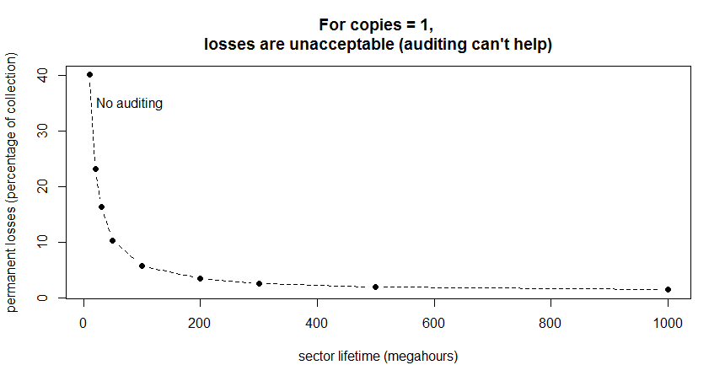
Hard to Compare Curves
e^{-something} is a fading exponential curve
Easier to compare if plotted as logs to straighten the lines

Slide 21
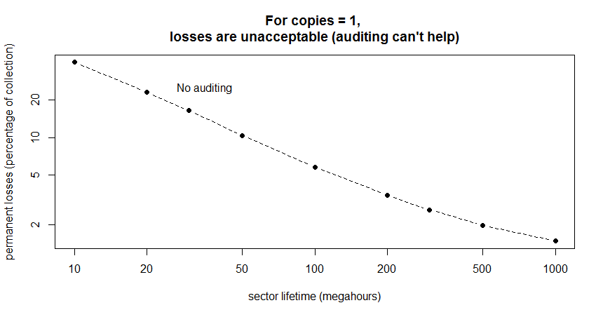
One Copy? All Losses Are Permanent Losses
Decreasing document losses
Increasing "quality" of storage
Length of time for storage to deteriorate and lose a document

Slide 22
Observations
For one copy, simple Poisson calculation yields failure rates

Slide 23
Good News & Bad News
Bad news: if anyone really understands the "quality" of modern storage, he/she is not talking
Good news: we *think* that modern storage methods, like those used in cloud storage, are very reliable, high quality
Strategy: Structure storage to protect your collection from variations in reliability

Slide 24
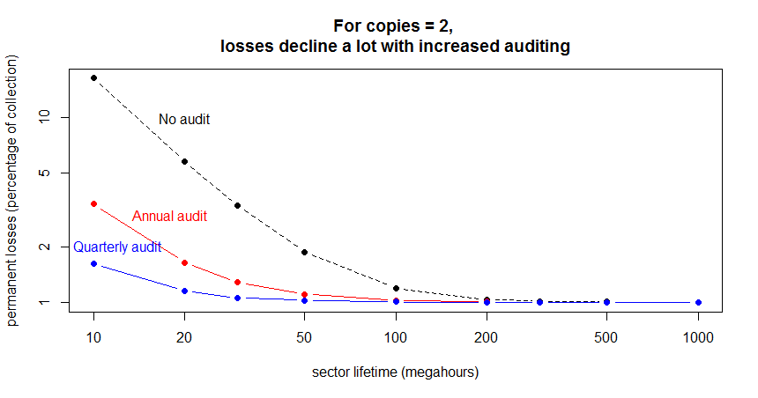
Two Copies? Definitely Not Enough
0

Slide 25
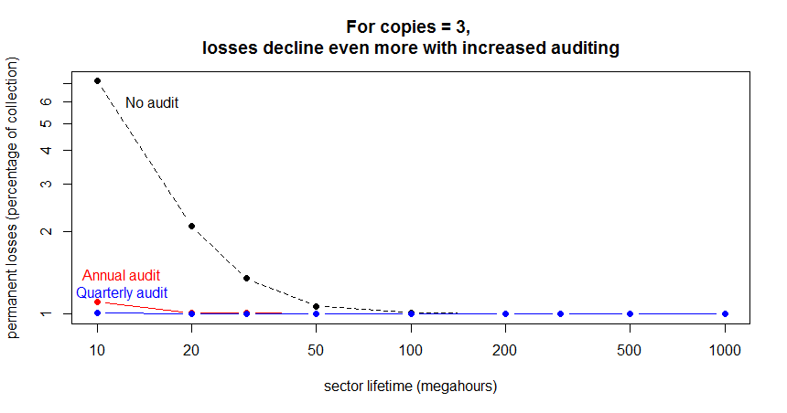
Three Copies? Marginal
0

Slide 26
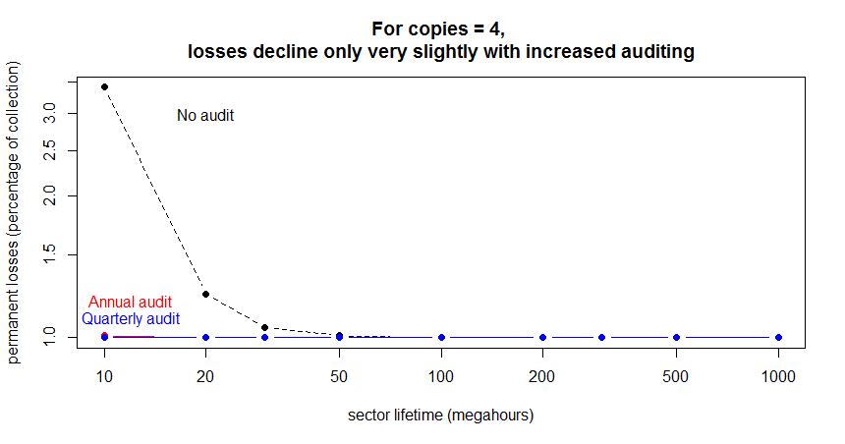
Four Copies? Looks Good
0

Slide 27
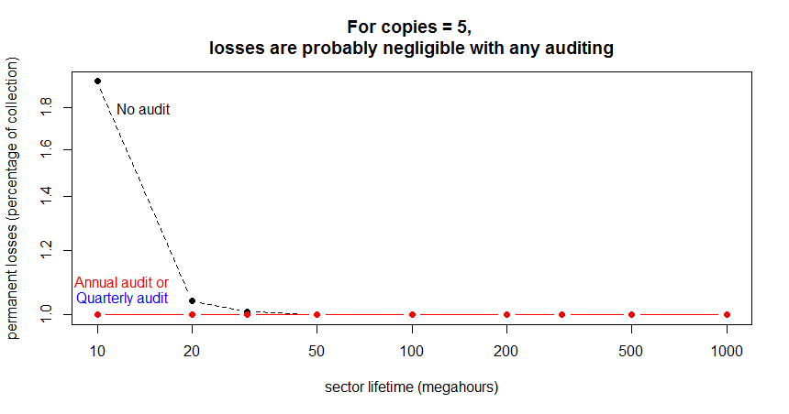
Five Copies? Works
0

Slide 28
Size Doesn't Matter (for Modeling)
Document sizes and error rates scale easily
Larger doc presents a larger target area
For a constant rate of block errors, larger doc will be hit more often
Scales precisely as you would expect
10x larger doc is hit 10x as often
OR
10x larger doc + 1/10 block error rate is hit 1x as often
(or 10x larger doc with 10x longer block lifetime)

Slide 29
Initial State With Small and Large Files
small file
10X larger file

Slide 30
Errors Are More Likely to Strike Larger Targets, Proportionally
before
after a while
small file
10X larger file
(errors strike in unused space, too)

Slide 31
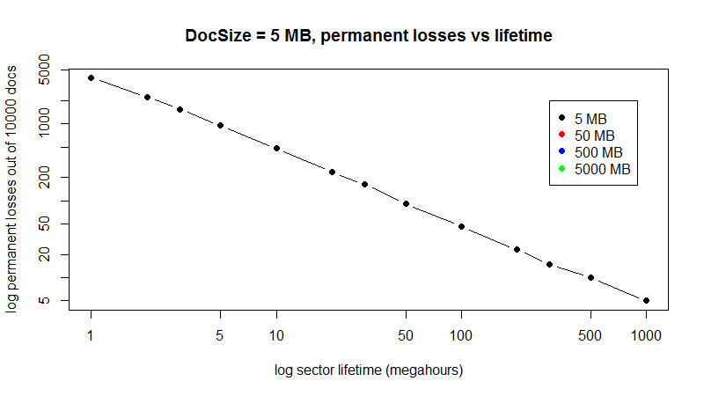
Measured Doc Losses vs Sizes and Lifetimes

Slide 32
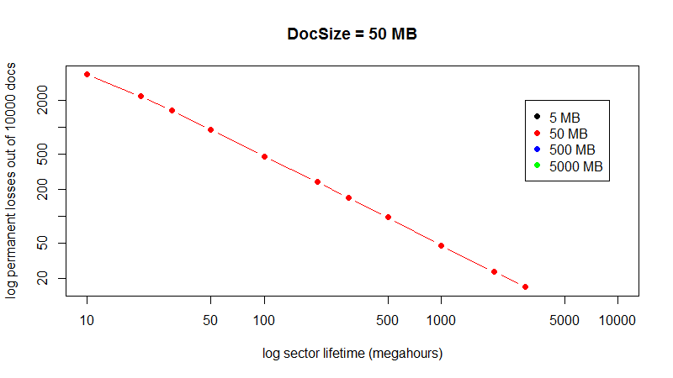
10X Larger Docs (50 MB)

Slide 33
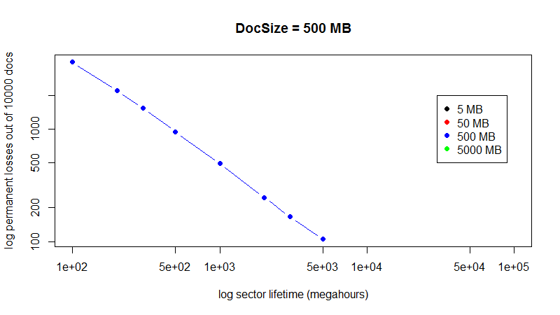
100X Larger (500 MB)

Slide 34
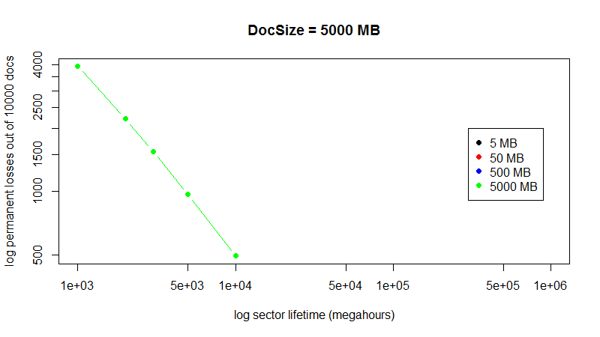
1000X Larger (5000 MB)

Slide 35
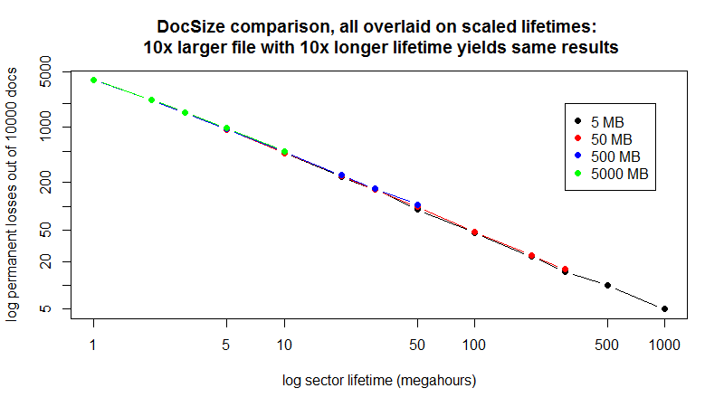
Re-scale Lifetimes to Match Various Sizes

Slide 36
Several Auditing Strategies
TOTAL: every audit cycle, check every copy of every document
SEGMENTED: check part of collection at intervals during the audit cycle
Entire collection checked every audit cycle (sampled without replacement)
RANDOM SEGMENTED: check randomly selected part of collection at intervals during the audit cycle
Selected with replacement: some documents will be missed in the cycle
POPULARITY: divide collection into pieces, audit some more frequently

Slide 37
Audit Assumptions
Client needs to retrieve object to audit
Auditing is limited by bandwidth – can’t do it too frequently
Bandwidth is limited, but not charged per unit
Recovery is possible – but may be more costly if not at least a majority of copies left…
Audits checks are reliable – audits take time, but complete (restartable) and are trustworthy

Slide 38
Tricky Audits Don't Help
Total or segmented audit is always better than random audit
E.g., auditing randomly selected 1/4 of the collection every quarter
Some documents will be missed entirely if the audit set is selected with replacement
(Note: segmented is very slightly better than total, because it looks at some failures earlier when failure rates are very high)

Slide 39
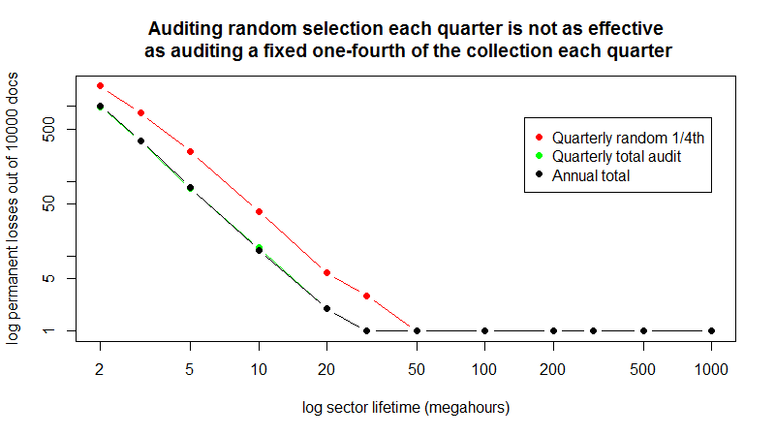
Random Selection Leaves Errors

Slide 40
Summary Observations – Phase 1
More copies are better (duh!) → but many copies often not necessary
Size of documents matter → but straightforward to assess effects of size, move to better storage or more copies
Auditing is essential to collection health
Protects collection over huge range of "quality”
Very frequent auditing is probably overkill
Tricky auditing (subsets, random) is less effective

Slide 41
Extensions [In Progress]
Document Fragility
Compression
Institutional Failure
Correlated Failures [In Progress]
Encryption
File Formats

Slide 42
Document Fragility
Assume: block failure damages a portion of document
block loss damages 1/R of document of
Rth portions can be verified and repaired independently
Value of partial documents is proportional to damage
→ Collections of repairable documents are modeled as a larger collections of smaller fragile documents
collection of N item of size S each R-repairable:
E(failures(N,S,R,...)) = E(failures(N*R,S/R,1,...))/R
Assume recoverablility rate R and compression rate C
Show how this is equivalent to changing collection and document size
Note that if C>R always a win
Note areas where if C<R still saves sufficient space to store another copy
Does this make up for higher failure rate from compression?

Slide 43
Modeling Compression
Assume
compression reduces document size to 1/C
compression reduces recoverability R’<R
If C>R compression is always a win
If R>R’ compression but C is high, may create extra copies
Compression could be a win
If C very small, or R>>R’ compression increases loss, even with an extra copy CP’
To decide – compare E(failure(original)) to E(failure(N,S/C,R’,CP’)

Slide 44
Institutional Failures Are Dangerous
You protect your collection with N copies
An institution fails, removing one copy entirely
Until this is discovered during the next audit cycle, you actually have only N-1 copies
If a second institution should fail near the same time, then only N-2 copies
Calibrating failures: mean-lifespan of small/mid/large-sized companies in targeted industry
Correlation of institutional failures?
Economic downturn
Regional conditions
Copies kept too close together, e.g, in-house

Slide 45
Recession → Failures → Losses
recessions increase rate
of institutional failure
failure every
10 years
expected permanent document losses due to institutional failures
you store enough copies to ensure no losses -- in normal circumstances
every
20 years
every
50 years
0
time

Slide 46
Modeling Encryption, Formats
Encryption, format failure adds correlated risk that entire collections cannot be read
Can model as correlated group-level (“server”)
Assume independence from storage-level risks
Diversify with multiple keys or formats/format readers
Adds to storage risk
→ E.g. single keyholder can be modeled as single-point institutional failure

Slide 47
What Next – Data Interpolation…
How many copies do you need to limit losses?
Limit permanent losses to some part of the collection?
Better: How many to keep likelihood of any permanent loss under some percentage?
5 per cent, 1 per cent, 0.1 per cent?
For institutional failures, how many copies to keep likelihood of total loss under some percentage?
Q: What information do you need to manage your libraries?

Slide 48
Additional References
Talagala, Nisha D. Characterizing large storage systems: error behavior and performance benchmarks. CALIFORNIA UNIV BERKELEY DEPT OF ELECTRICAL ENGINEERING AND COMPUTER SCIENCES, 1999.Failure Trends in a Large Disk Drive Populations
Shah, Mehul A., Mary Baker, Jeffrey C. Mogul, and Ram Swaminathan. "Auditing to Keep Online Storage Services Honest." In HotOS. 2007.Beyond MTTDL: A Closed-Form RAID 6 Reliability Equation
Hughes, Gordon F., and Joseph F. Murray. "Reliability and security of RAID storage systems and D2D archives using SATA disk drives." ACM Transactions on Storage (TOS) 1, no. 1 (2005): 95-107.Backblaze Blogs
Schroeder, Bianca, and Garth A. Gibson. "Disk failures in the real world: What does an MTTF of 1, 000, 000 hours mean to you?." In FAST, vol. 7, pp. 1-16. 2007.
Heydegger, Volker. "Just one bit in a million: On the effects of data corruption in files." In Research and Advanced Technology for Digital Libraries, pp. 315-326. Springer Berlin Heidelberg, 2009.Disk Failure Investigations at the Internet Archive
Rosenthal, David SH. "Keeping bits safe: how hard can it be?."Communications of the ACM 53, no. 11 (2010): 47-55.Providing High Reliability in a Minimum Redundancy Archival Storage System
Gray, Jim, and Catharine Van Ingen. "Empirical measurements of disk failure rates and error rates." arXiv preprint cs/0701166 (2007).A Fresh Look at the Reliability of Long-term Digital Storage
Graf, Roman, and Sergiu Gordea. "A risk analysis of file formats for preservation planning." In Proceedings of the 10th International Conference on Preservation of Digital Objects (iPres2013), pp. 177-186. 2013.Disk Scrubbing Versus Intra-Disk Redundancy for High-Reliability RAID Storage Systems
Li, Yan, Ethan L. Miller, and Darrell DE Long. "Understanding data survivability in archival storage systems." In Proceedings of the 5th Annual International Systems and Storage Conference, p. 16. ACM, 2012.
Backblaze Corporation, “What Can 49,056 Hard Drives Tell Us? Hard Drive Reliability Stats for Q3 2015
“, Backblaze Blog.

Slide 49
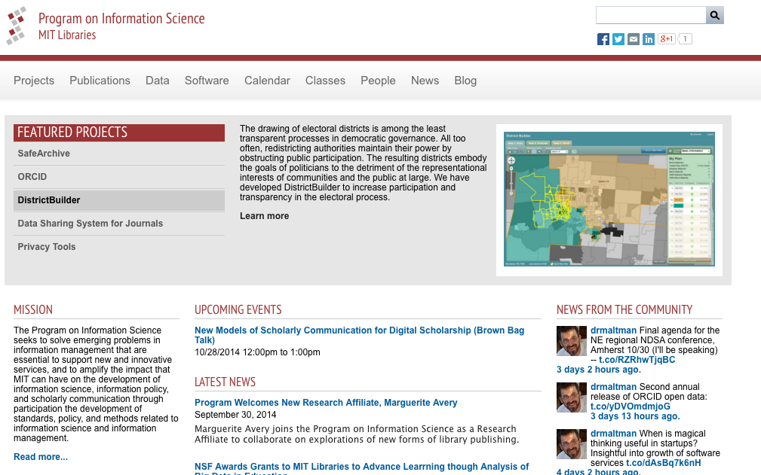
Questions?
E-mail: escience@mit.edu
Web: informatics.mit.edu

Slide 50
Creative Commons License
This work. Managing Confidential information in research, by Micah Altman (http://redistricting.info) is licensed under the Creative Commons Attribution-Share Alike 3.0 United States License. To view a copy of this license, visit http://creativecommons.org/licenses/by-sa/3.0/us/ or send a letter to Creative Commons, 171 Second Street, Suite 300, San Francisco, California, 94105, USA.

